Slide 1
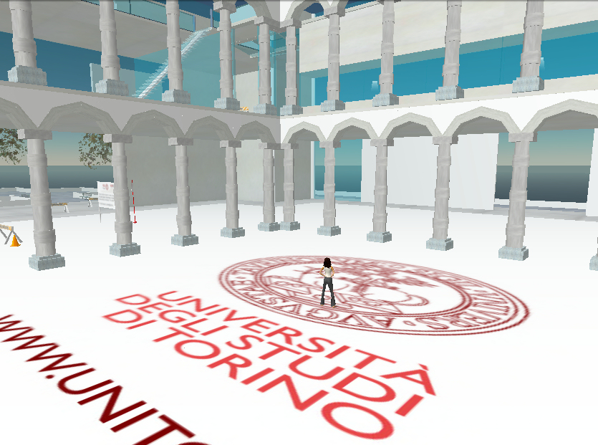
ATELIER COMPLEXITÉ ET POLITIQUES PUBLIQUES, 2E ÉDITION, LYON, 22 MAY 2015
Complexity, Public Policies, and the Role of Network Theory in Legal Information for Reality
Ugo Pagallo (Torino Law School)

Slide 2
Outline
Introduction
Complexity and legal networks
Legal networked information
3.1 “As Reality”
3.2 “About Reality”
3.3 “For Reality”
4. Conclusions

Slide 3
1/4 Introduction
Complexity is a complex notion of its own…
From a legal viewpoint, we may think of:
1. The algorithmic theory of information
2. The theory of spontaneous orders
3. System theory
Since particular attention will be drawn to the tenets of legal networks, approaches (1) and (2) deserve some further illustration…

Slide 4
1/4 Introduction
Information
Complexity
Computation

Slide 5
1/4 Introduction
Information
Spontaneous Orders
Evolution

Slide 6
1/4 Introduction
Let us deepen such approaches to the law as information (and algorithmic compression, and the emergence of spontaneous orders, and…) with the tenets of network theory.
Accordingly, legal information is grasped as a matter of nodes, edges, diameters and average distances, geodesic points, clustering coefficients and the like

Slide 7
2/4 Complexity and legal networks

Slide 8
2/4 Complexity and legal networks
All the network approaches to the law represent the legal phenomenon in terms of information and yet, we can further the connection between information and legal networks from different perspectives

Slide 9
3/4 Legal networked information
By referring the connection between legal networks and information to the notion of reality, we obtain three different levels of abstraction:
Legal information “as” reality
Legal information “about” reality
Legal information “for” reality

Slide 10
3/4 Legal networked information
Such a threefold level of analysis needs a further conceptual ingredient, namely that of data.
Hence, from this viewpoint, I assume:
• Information = that which is made of data (e.g. information = data + meaning), and
• Data = that which is made of lack of uniformity in the real world if, and only if, such data is additionally well formed and meaningful

Slide 11
3.1/4 LNI “as” Reality
Legal networked information (LNI) “as” reality refers to data that can be meaningful independently of an intelligent producer/informer. Think of the series of concentric rings visible in the wood of a cut tree trunk, which allows us to estimate the age of that tree. This perspective has become popular in the field of evolutionary psychology, according to which basic human concepts would be wired in our brains thus grounding cultural evolution.

Slide 12
3.1/4 LNI “as” Reality
This stance specifies as well, that which all the variables of the natural law tradition have in common, namely the examination of being qua being, or its essence, so that law could be found in the nature of the individuals, of the world, of the things, i.e. the German “Natur der Sache.” However, we do not have to buy these ideas so as to grasp the beauty of today’s work on complexity, information, and legal networks

Slide 13
3.1/4 LNI “as” Reality
The US Supreme Court
The Italian Const’l Court

Slide 14
3.1/4 LNI “as” Reality
The French codes
The EU CoJ

Slide 15
3.1/4 LNI “as” Reality
So far, so good…
Since this is not the topic of my presentation, let me skip this point and focus on the second kind of relation between network theory and legal information

Slide 16
3.2/4 LNI “about” Reality
Here, we have to do with matters of knowledge and concepts that frame the representation and function of a given system, and inform us about the different states of reality. LNI “about” R, in other words, refers to semantic information, which is alethically qualifiable. This viewpoint can be elucidated by work on legal sociology.

Slide 17
3.2/4 LNI “about” Reality
Think of Max Weber’s research, or of some variants of legal realism, such as the American (as opposed to the Scandinavian) legal realism. Here, the law is conceived as a sort of prophecy of what the courts will do in fact (e.g. Holmes). Although this approach is mostly popular in the common law area, it does fit many instances of the civil law tradition.

Slide 18
3.2/4 LNI “about” Reality
After all, people ask for legal information about reality every time they visit a lawyer’s office or a clerk to the justices. Moreover, since they are dealing with semantic content information, which is alethically qualifiable, what people hope is that such lawyer, clerk, or attorney, will speak the truth!

Slide 19
3.3/4 LNI “for” Reality
Finally, we deal with the law understood as a set of rules or instructions for the determination of other informational objects. This is the most usual and even important type of information in the legal domain, that is, legal networked information “for” reality. Let us now examine how network theory can be useful also at this level of abstraction…

Slide 20
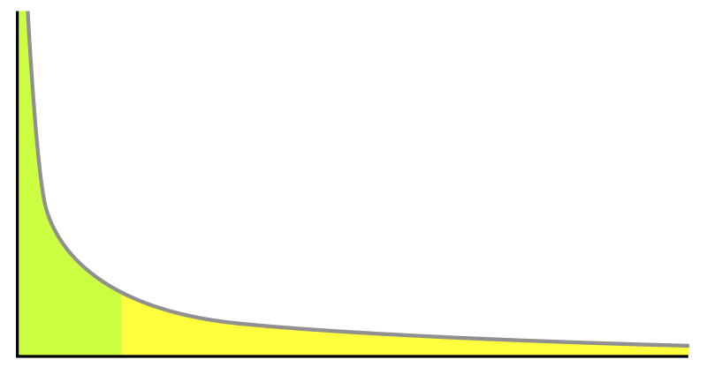
3.3/4 LNI “for” Reality
The outcomes of network theory can be fruitful so as to (contribute to) bring about something, because the topological properties of the network and the degree of complexity may affect the political planning of lawmakers and their choices.

Slide 21
3.3/4 LNI “for” Reality
For example, “in a scale-free network, we know that we need to identify the well-connected individuals and to try by some means to induce them to change their behaviours. In a random network, we know that there is a critical value of the proportion of agents we need to influence in order to encourage or mitigate the spread of a particular mode of behaviour or opinion across the network…” (Ormerod 2012, to be continued)

Slide 22
3.3/4 LNI “for” Reality
“…This at least gives us an idea of the scale of the effort required, and tells us that money and time which is unlikely to generate the critical mass is money and time wasted. In a small-world context, targeting our efforts is more difficult, but at least we know that it is the long-range connectors, the agents with links across different parts of the network, or who have connections into several relevant networks, who are the most fruitful to target” (op. cit., 275).

Slide 23
3.3/4 LNI “for” Reality
Of course, further instances of this approach can be given, e.g. p2p systems, narcotic networks, down to that specific legal system which is Facebook…

Slide 24
4/4 Conclusions
The conclusions are twofold. First, from a procedural stance, the distinction between legal information “as” reality, “about” reality, and “for” reality, does not suggest that we should conceive them as worlds apart. Some undisputed champions of the law as information for reality, such as Hobbes and Kelsen, clarify why the different levels of analysis interact.

Slide 25
4/4 Conclusions
In chapter 21 of Leviathan, on the one hand, Hobbes admits that “the obligation of subjects to the sovereign is understood to last as long, and no longer, than the power lasteth by which he is able to protect them.”

Slide 26
4/4 Conclusions
A similar connection between these levels of legal information reappears, on the other hand, in Kelsen’s General Theory of Law: “a norm is considered to be legally valid… on the condition that it belongs to a system of norms, to an order which, on the whole, is efficacious” (ed. 1949: 42).

Slide 27
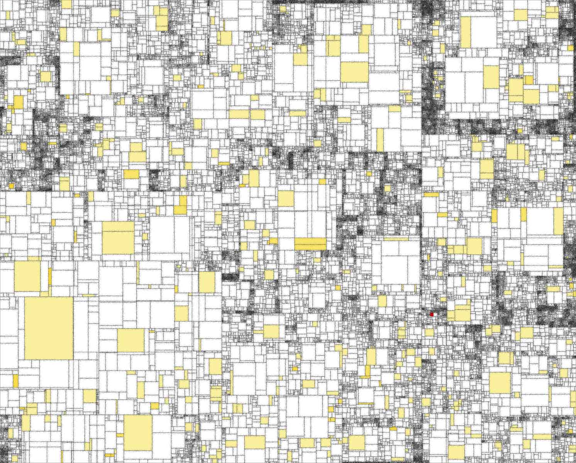
4/4 Conclusions
Levels of Abstraction (Brut 1985)
Along with these “procedural” remarks on how the 3 LoAs interact, a normative approach follows as a result.

Slide 28
4/4 Conclusions
Work on legal information “about” reality and “as” reality can help legislators when they set the rules, or instructions, for the determination of other informational objects in the system, namely legal information “for” reality. Policy makers and governance actors should indeed know the subject matter they intend to govern.

Slide 29
4/4 Conclusions
If you think the latter proviso is a truism, it is not, for this is the bread and butter of scholars focusing on the regulation of the internet; making laws for cyberspace; proposing new economic models for the online world, and so forth. The price of ignoring semantic information with factual content often ends up with the making of further contentious cases (see work with Agnoloni at Jurix’s NAIL 2014)

Slide 30
4/4 Conclusions
“Nothing is more terrible than ignorance in action.”
(Wolfgang Goethe)

Slide 31
THANK YOU VERY MUCH
ugo.pagallo@unito.it
University of Torino, Italy

Slide 32
References
Pagallo, U. 2006. Teoria giuridica della complessità. Giappichelli, Torino.
Floridi, L. 2009. A Very Short Introduction to Information. Oxford University Press, Oxford.
Fowler, J. H., and S. Jeon 2008. The Authority of Supreme Court Precedent, Social Networks, 30: 16-30.
Malmgren, S. 2011. Towards a Theory of Jurisprudential Relevance Ranking: Using Link Analysis on EU Case Law. Master of Laws degree at Stockholm University under the supervision of C. Magnusson Sjöberg.
Agnoloni, T. and U. Pagallo 2014. The Case Law of the Italian Constitutional Court between Network Theory and Philosophy of Information, NAIL Workshop at Jurix, Krakow (Poland), December.
Pagallo, U. 2010. As Law Goes By: Topology, Ontology, Evolution, in AI Approaches to the Complexity of Legal Systems. Complex Systems, the Semantic Web, Ontologies, Argumentation, and Dialogue, edited by P. Casanovas et al., 12-26. Springer, Dordrecht.
Boulet, R., Mazzega, P. and Bourcier, D. 2010. Network Analysis of the French Environment Code, in AI Approaches to the Complexity of Legal Systems. Complex Systems, the Semantic Web, Ontologies, Argumentation, and Dialogue, edited by P. Casanovas et al., 39-53. Springer, Dordrecht.
Ormerod, P. 2012. Positive Linking. Faber and Faber, London.
Glorioso, A., Pagallo, U., and Ruffo, G. 2010. The Social Impact of P2P Systems, in Handbook of Peer-to-Peer Networking, edited by X. Shen, H. Yu, J. Buford and M. Akon, 47-70. Springer, Heidelberg.
Kaza, S., Xu, J., Marshall, B. and H. Chen 2005. Topological Analysis of Criminal Activity Networks in Multiple Jurisdictions, dg.o '05 Proceedings of the 2005 National Conference on Digital Government Research, 251-252.
Murray, A. D. 2007. The Regulation of Cyberspace: Control in the Online Environment. Routledge-Cavendish, New York.
Reed, Ch. 2012. Making Laws for Cyberspace. Oxford University Press, Oxford.
Cerf, V., Ryan, P. and M. Senges 2014. Internet Governance is Our Shared Responsibility, A Journal of Law and Policy for the Information Society, 10(1): 1-41.
Pagallo, U. 2015. Good Onlife Governance: On Law, Spontaneous Orders, and Design, in The Onlife Manifesto, edited by L. Floridi, 161-179. Dordrecht, Springer.

