Slide 1
Strengthening Local and Regional Health Systems for Improved Disease Surveillance
Lessons from an interdisciplinary study of three Regencies in East Java, Indonesia
Bianca van Bavel

Slide 2
TRANS-DISCIPLINARY APPROACH
Epidemiology
Anthropology
Biology
Immunology
Ecology
Veterinary
Psychology
Policy
Notes:
Similarly public policies become a subject in its own right since the so-called linear policies do not seem to take into account the complexity of networks of actors, standards and resources involved in a system of standards.

Slide 3
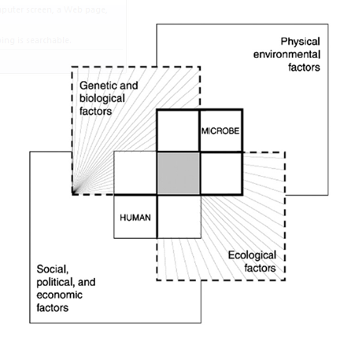
Complexities of health
The interactions and determinants of human health (Xu et al., 2008)
Notes:
FIGURE Depicts the complexities of interactions and determinants of human health (taken from Xu et al., 2008)
Disease Epidemiology is Variable and depends on:
Host Factors
Exposure Factors
Environmental Factors
Bacterial/Pathogen Factors

Slide 4
An inclusive approach to health, which highlights local-global perspectives and trans-disciplinary approaches to achieve optimal health for people, animals and the environment through the understanding of disease complexities.
ONE HEALTH
FAO, OIE, WHO 2010; Conrad et al, 2013; Robozzi, 2012

Slide 5
Diseases or infections caused by bacteria, parasites, fungi, viruses or other unconventional agents, that are transmissible from vertebrate animals to humans and vice versa
Presently, more than 60% of all infectious diseases are caused by zoonotic pathogens
Today we will be addressing Leptospirosis—a bacterial zoonotic
zoonoses

Slide 6
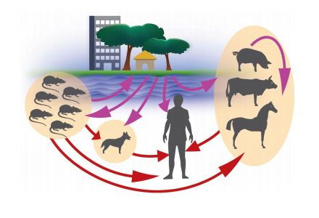
TRANSMISSION CYCLE
Notes:
-Leptospira bacterial transmisison
-Commonly transmitted directly to humans through infected urine of rodent reservoirs, and (depending on the context) other animals, and indirectly via contaminated water and soil.
Disease Epidemiology is Variable and depends on:
Host Factors
Exposure Factors
Environmental Factors
Bacterial/Pathogen Factors

Slide 7
Misrepresentation & Under-reporting
Diagnostic & Surveillance Challenges
Dengue, Malaria and Meningitis Endemicity
Worldwide Disease Distribution And Range
Disproportionate Burden Of Disease
Leptospirosis
‘A Zoonosis of Global Importance –Bharti et al. 2003
Notes:
INTRODUCTION: Despite being one of the most widely distributed zoonotic infections worldwide, leptospirosis has a disproportionately concentrated burden of infection in tropical, low-and middle-income settings. Particularly, in regions with endemic Dengue, Malaria, Menigitis,
-Symptoms

Slide 8
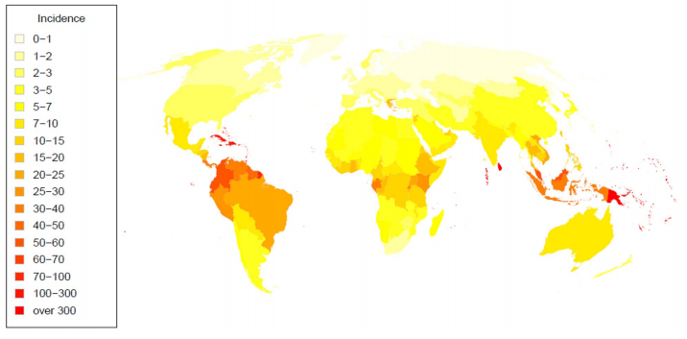
Distribution & Hotspots
*Incidence per 100,000 people, Global Leptospirosis Environmental Action Network (GLEAN, 2014)
Notes:
7-10 MILLION people contract Lepto each year.
0.1-1/100,000 people (temperate)
10+/100,000 people (tropical)
Leptospirosis has a disproportionately concentrated burden of infection in tropical environments (warm/wet/seasonal variability/extremes), with high prevalence in low-and middle-income populations (poor sanitation, rapid urbanization, land use change) along with well-accepted occupational associations (agriculture, farming, abattoir etc.)

Slide 9
Low-and-Middle Income Countries
Poor Sanitation
Waste Disposal
Water Management
Demographic Changes
Rapid Urbanization and Over-Crowding
Occupational Associations
Anthropogenic Environmental Pressures
Land Use Change
Tropical Climates
Extreme Seasonal Variability
Flooding…Environmental Contamination…Stagnant Water…Soil Saturation
Hotspots & vulnerabilities

Slide 10
With evidence of a nationwide increase in reported cases of leptospirosis since 2006, the situation in Indonesia was identified as both a ‘severe and highly underestimated’ public health threat.
However current surveillance records showed large gaps in reporting, with numerous regencies only having collected data for one or two years during this period (2007-2013), if at all.
Context
Notes:
Inaccurate reporting of the current incidence of leptospirosis in Indonesia poses an issue to current public health and disease surveillance systems.

Slide 11
Severe flooding in April-May
Outbreak of Leptospirosis
Over 2 weeks regional reported incidences:
89 suspected and probable cases
47 deaths from confirmed cases
Some communities recorded Case Fatality Rates as high as:
7.14% (Banyuanyar)
17.24% (Kamoning)
Investigative regional report was launched in response
Sampang 2013

Slide 12
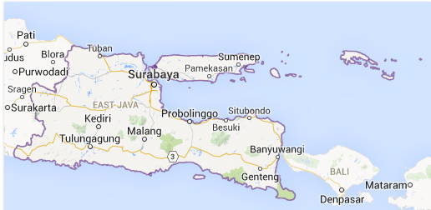
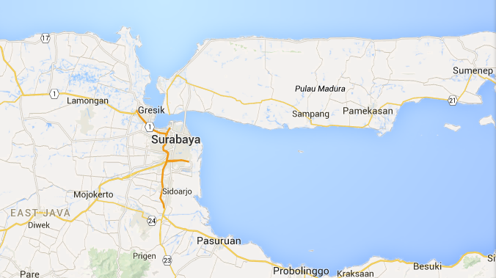
Case study
Notes:
MAP
Inaccurate reporting of the current incidence of leptospirosis in Indonesia poses an issue to current public health and disease surveillance systems.

Slide 13
Starting with Existing Provincial and Regional Records of Probable or Suspected Cases of Leptospirosis (2014)
Then Employing Trans-Disciplinary Epidemiological and Ethnographic Methods of Investigation at the Community Level
Surveyed 9 communities (3 Regencies)
Household questionnaire of socio-environmental determinants(n= 275)
Passive observation
Number of self-reported cases were cross-referenced with clinical records derived from positive molecular diagnostic evidence
Statistical and Thematic Analysis
Binary Logistic Regression
Multivariate
Study design

Slide 14
Multi-stage purposive sampling
Criteria of highest reported incidence of Leptospirosis (2013-2014) was applied to each administrative level
Reported Probable or Suspected Case Histories of Leptospirosis
Self-reporting
Self-reported case numbers were cross-referenced with clinical records derived from positive molecular diagnostic evidence
Study design

Slide 15
SURABAYA
P. KELING
1
2
3
SAMPANG
BANYUANYAR
4
5
6
KAMONING
7
8
GRESIK
CERME
D. SAMPEYAN
9
Notes:
Given the epidemic extent of leptospirosis reported in the study areas, multi-stage purposive sampling techniques were used to select units from each sampling strata [44, 13, 45, 37]. Using the same criteria of highest reported incidence of leptospirosis for 2013-2014, each DKK provided the principle researcher with the next administrative sampling frame of Community Health Clinics (Puskesmas: Pecar Keling, Banyuanyar, Kamoning, Duduk Sampeyan, and Cerme). Local health clinic administration applied the same criteria at the next administrative level to select nine sites (Villages: Pacar Keling, Rongtengah, Dalpenang, Kamoning, Paseyan, Gunung Sekar, Gredek, Betiting, and Jono). Systematic sampling was applied within each village strata, and ranged from 25-50 household units, which was large enough to achieve saturation, account for variation, and representativeness within the target population [36, 46, 45, 47]. Systematic documentation of passive observational data was collected by researchers in the form of field notes, discussions and photographs.

Slide 16
Participant Demographics
Median Age | 41
Rural : Urban | 50:50
Male | 44%
Living in Flood Zones | 60% (1/3 reporting in-house)
Daily Rodent Sightings Domestic Environment | 87%
<20 m from Open Sewage | 96.7%
Access to PDAM | 60%
* Perusahaan Daerah Air Minum (PDAM) is the regional water utility provider of in-house piped running water
results
Notes:
PDAM is regional water utility Co.

Slide 17
Household Variable % |  |  |  |  | Individual Variable %
 | Access To PDAM | Artesian Well Source | History Of Flooding | <20m To Refuse | Occupational Farming | Reported Leptospirosis
Pacar Keling N=50 | 94 | 28 | 2 | 22 | 0 | 4
Rongtengah N=28 | 78.6 | 57.1 | 28.6 | 25 | 7.1 | 14.3
Dalpenang N=36 | 75 | 22.2 | 44.4 | 63.9 | 0 | 16.7
Kamoning N=25 | 0 | 100 | 36 | 80 | 88 | 24
Paseyan N=24 | 75 | 87.5 | 41.7 | 95.8 | 83.3 | 29.2
Gunung Sekar N=26 | 100 | 0 | 34.6 | 57.7 | 0 | 0
Gredek N=36 | 0 | 16.7 | -- | 63.9 | 50 | 8.3
Betiting N=25 | 100 | 0 | -- | 0 | 0 | 0
Jono N=25 | 0 | 92 | 12 | 32 | 16 | 8

Slide 18
Social-Environmental Associations | Reported Case History
 | OR | 95% CI | P
Living in a flood zone | 4.06 | 1.50—10.98 | 0.006
In House Flooding within the past Month | 4.43 | 1.90—10.33 | 0.001
Type of Residence (Rural) | 1.61 | 0.74—3.49 | 0.230
Housing Density ( ≥50 HH/ 10,000 m²) | 0.40 | 0.18—0.85 | 0.018
Access to PDAM | 0.44 | 0.20—0.95 | 0.037
Water Source at HH (Artesian Well/ Air Sumur) | 6.28 | 1.80—21.94 | 0.004
Water Source at HH (River) | 4.37 | 0.92—20.86 | 0.060
Last Completed Level of HH Education (≥SMP) | 0.46 | 0.22—0.99 | 0.049
Level of HH Income (<Rp. 1,000,000) | 2.27 | 0.99—5.20 | 0.054
Living <20m to Open Sewage | 4.16 | 0.55—31.74 | 0.170
Living <20m to Refuse Depot | 2.57 | 1.15—5.74 | 0.021
Frequency of Refuse Pickup (Daily) | 3.80 | 1.28—11.29 | 0.016
Farming Occupation | 2.76 | 1.23—6.18 | 0.014
Gender (Male) | 1.61 | 0.71—3.65 | 0.250
*Abbreviations: OR, Odds Ratio; CI, Confidence Interval; HH, Household; PDAM, Perusahaan Daerah Air Minum
results
Notes:
In explanation, determinants of slum health are not exclusive to living in urban areas with higher housing densities alone. Rather, the majority of households and communities in this study, urban and rural alike, were living in similarly defined social-economic and environmental circumstances; as indicated by the poor state of sanitation, waste management, water protection and treatment (Figures 1 & 2), as well as the number of inhabitants per household [56, 51, 10, 12]. It follows that targeted leptospirosis interventions need to comply with the heterogeneity of disease transmission factors as well as the complexity of socio-economic and environmental determinants.

Slide 19
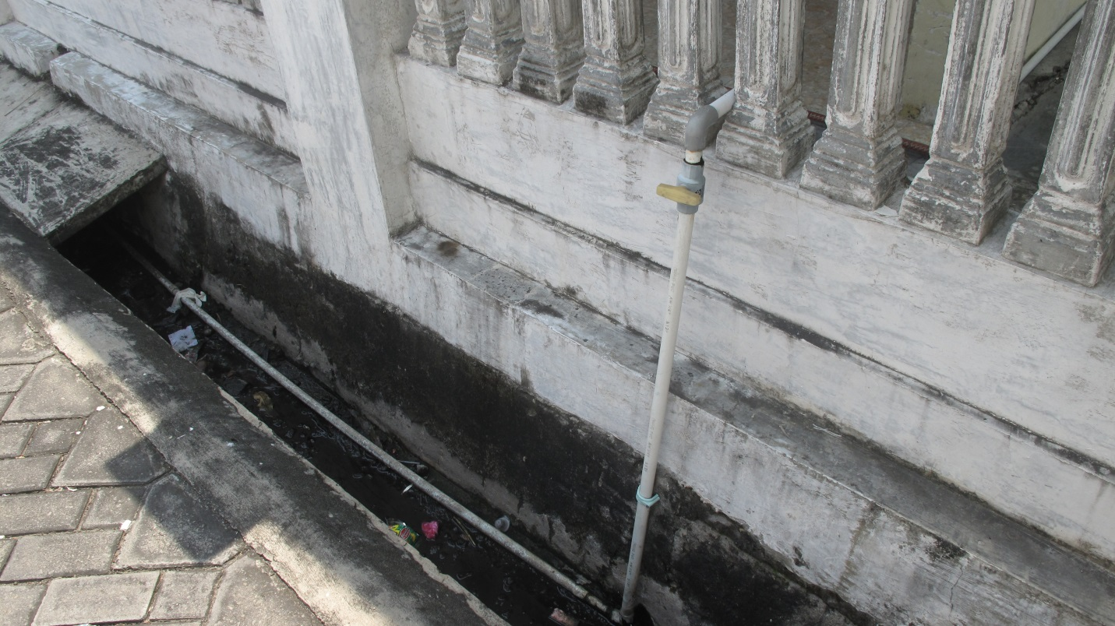
Household water source and sewage canal in Jono, Gresik
results
Notes:
This figure shows mixed sewage canal and tapped water sources for communities in Jono, Gresik. There is no PDAM coverage for households in this village, rather the pipes shown here supply water from a network of drilled wells and pumps. The community has complained about the supply and quality of the water.

Slide 20
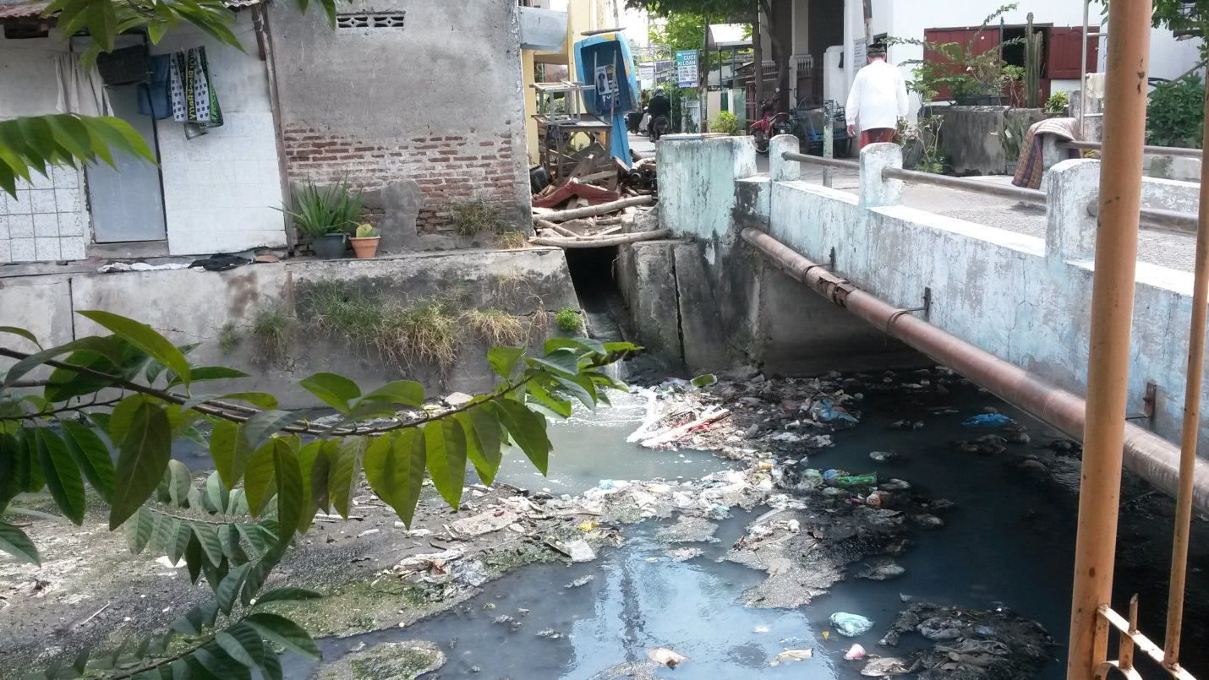
Sewage proximity, drainage and contamination in Pecar Keling, Surabaya
results
Notes:
This figure shows the extent of sewage and waste management for the community and catchment areas of Pecar Keling, Surabaya. It depicts the proximity of households to open accumulated sewage and contamination from mixed waste sources.

Slide 21
Slum health (1)
Despite the complex and variable disease epidemiology
Communities had similarly defined environmental and socio-economic circumstances
‘Slum Health’ not restricted to urban environments
Interventions should be targeting Urban and Rural communities alike
Improved sanitation, access to safe water, and effective waste management and drainage systems are all essential determinants of both individual and community health and disease prevention
So how do we incentivize the inclusion of these vulnerable populations in government discussions and policy decisions?
Riley et al.,2007; Felzemburgh et al., 2014; Reis et al., 2008; Marmot et al., 2008; Barcellos & Sabroza, 2000; Ko et al., 1999
Notes:
The majority of households and communities in this study, urban and rural alike, were living in similarly defined socio-environmental and economic circumstances; defined by poor sanitation, poor waste management, limited water protection and treatment (Figures 1 & 2) [57]. To inform the global leptospirosis targeting of urban settings and slum health interventions may not be sufficiently contextualized. Therefore future interventions need to comply with the heterogeneity and complexity of disease transmission factors [58].

Slide 22
Contextual challenges
Government Decentralization
Re-structuring Post-Suharto Era (1999/2000)
Fragmented delivery of public services
I.E. PDAM- Regionally operated water utility company (over 300 discrete units)
Onus is on municipalities and local communities
Infrastructure
Environmental contamination (Flood Zones)
Protection and treatment of water at source and in-house
Limited Resources
Access and Availability of Diagnostics (timing, quality)
Human and Clinical Capacities
Notes:
The majority of households and communities in this study, urban and rural alike, were living in similarly defined socio-environmental and economic circumstances; defined by poor sanitation, poor waste management, limited water protection and treatment (Figures 1 & 2) [57]. To inform the global leptospirosis targeting of urban settings and slum health interventions may not be sufficiently contextualized. Therefore future interventions need to comply with the heterogeneity and complexity of disease transmission factors [58].

Slide 23
Social-Environmental Associations | Reported Case History
 | OR | 95% CI | P
Living in Sampang Regency | 3.55 | 1.29—9.74 | 0.014
Regional Discrepancies (2)
Notes:
Living in Banyuanyar Clinic Area
4.80
1.00—23.05
0.050
Living in Kamoning Clinic Area
5.67
1.22—26.41
0.027
Living in Paseyan Village
6.71
1.20—37.44
0.030

Slide 24
“Sampang has always had rats and floods, only now do we have these outbreaks of leptospirosis…why now, what has changed?”
Government Employee, Agricultural Department, Dalpenang, Banyuanyar Health Centre (Field Notes: Day 10)
Notes:
Despite the sense of questioning despair reflected by the above quote, it reflects a local change in diagnostics and disease specific awareness. There still remain more queries into public health response systems and the current situation of leptospirosis and its underlying socio-environmental determinants for these hot spots and vulnerable populations.
It has been shown that by improving surveillance vigilance and local awareness, providing accessible early diagnosis and resources to avail of immediate treatment can prevent outbreaks and reduce the risk of mortality among patients presenting in the acute phase of infection [44, 6]. Still, these systems require human resources and technical support of adequate laboratory testing, and accurate case confirmation in order to operate successfully. Unfortunately, human resources and technical laboratory support are often limited, or absent where they are needed the most, in disease hotspots such as Indonesia.
Further weaknesses of leptospirosis surveillance systems and reporting practices include limited capacity to manage the data being collected, as well as an insufficient policy backing [63].

Slide 25
Anomaly with improved regional reporting in Sampang
Heightened surveillance and awareness following the outbreak
We need to look at the positive deviances
Can this information be used to benefit other regional and provincial responses?
Lessons to learn
Notes:
Leptospirosis infection does not typically develop into severe manifestations and due to lack of awareness, similar presentations with other endemic acute febrile illnesses, and inadequate diagnostic support, it is more likely for infections to go clinically unrecognized [15, 5, 25]. This could account for the discrepancies in diagnostic surveillance between community health clinics and reporting within the formal regional and wider provincial health centres. The reports administered by the Provincial Health Authorities (DKPJT) in 2014, show large inconsistencies in the number of cases reported, with most regencies having data for one or two years, and many none at all [14]. For example, since 2011 there were as few as 120 suspected cases, 76 probable cases, and 27 deaths related to leptospirosis in Surabaya, and in particular for Gresik regency, which reported as few as 14 suspected, 4 probable, and no deaths between 2007 and 2014. These numbers suggest that there may be an even higher infection-to-disease ratio than that reflected by formal surveillance reporting. Fortunately, the reports from the Sampang regional inquiries of 2013[29], did feed in to the generation of this provincial report. Perhaps, this can be used to incentivise more dialogue between local, regional and provincial systems.
RECALL:
Disease Epidemiology is Variable and depends on:
Host Factors
Exposure Factors
Environmental Factors
Bacterial/Pathogen Factors

Slide 26
Uncoordinated Regional Offices (Health, Sanitation, Agriculture etc.)
Poorly linked with community health clinics
Higher infection-to-disease ratio as evidence by reporting discrepancies
The East Java Provincial Health Office hugely under-reported only 153 suspected cases, 204 probable cases and 41 deaths associated with leptospirosis (from 2007 to 2014)
Estimates of 120 suspected, 76 probable, 27 deaths in Gresik Regency 2011—2014 (Provincial Health Authorities)
All numbers were inconsistent with community health records
Systems coordination
Notes:
Leptospirosis infection does not typically develop into severe manifestations and due to lack of awareness, similar presentations with other endemic acute febrile illnesses, and inadequate diagnostic support, it is more likely for infections to go clinically unrecognized [15, 5, 25]. This could account for the discrepancies in diagnostic surveillance between community health clinics and reporting within the formal regional and wider provincial health centres. The reports administered by the Provincial Health Authorities (DKPJT) in 2014, show large inconsistencies in the number of cases reported, with most regencies having data for one or two years, and many none at all [14]. For example, since 2011 there were as few as 120 suspected cases, 76 probable cases, and 27 deaths related to leptospirosis in Surabaya, and in particular for Gresik regency, which reported as few as 14 suspected, 4 probable, and no deaths between 2007 and 2014. These numbers suggest that there may be an even higher infection-to-disease ratio than that reflected by formal surveillance reporting. Fortunately, the reports from the Sampang regional inquiries of 2013[29], did feed in to the generation of this provincial report. Perhaps, this can be used to incentivise more dialogue between local, regional and provincial systems.
RECALL:
Disease Epidemiology is Variable and depends on:
Host Factors
Exposure Factors
Environmental Factors
Bacterial/Pathogen Factors

Slide 27
Evidence shows poorly coordinated systems lead to poor health outcomes
Regional response systems and internally generated surveillance initiatives play an integral role towards strengthening the structural and functional capacities of local health systems
Coordinated referral networks in place
Local, Regional, Provincial
Multi-Sectoral Alignment of Regional Offices
Health, Agricultural, Sanitation, Irrigation Departments
Systems
Strengthening
Notes:
Ministerial Decentralisation
I.E. Kamoning Health Clinic, Sampang Regional Health Offices, and Regional Ministry
The efficacy and timeliness of public health responses depend on the capacities and abilities of health systems to motivate action through accurate and timely information
This requires the ongoing support and coordination of local, regional and provincial systems

Slide 28
informing policy change
The efficacy of public health systems are only as strong as the policies from which they are motivated
How do we translate the complexity of systems and determinants of health into policy?
Challenging ‘linear’ perceptions
How does policy become inclusive and contextualised to ensure that these systems are supported and strengthened?
Can taking a disease-centred approach be detrimental to the wider health system?
Recognizing the biases and limitations in our approaches
Notes:
Similarly public policies become a subject in its own right since the so-called linear policies do not seem to take into account the complexity of networks of actors, standards and resources involved in a system of standards.
From Local→ Regional→ Provincial→ National
REFLEXIVITY

Slide 29
Acknowledgements
Fiona Larkan—Centre for Global Health, School of Medicine, Trinity College Dublin Ireland
Purwati & Usman Hadi—Dr. Soetomo Teaching Hospital, Institute of Tropical Diseases, Airlangga University, Surabaya, Indonesia
Jarlath E. Nally—National Animal Disease Center, Agricultural Research Services, United States Department of Agriculture, Ames, Iowa, USA
Marco Goeijenbier & Eric van Gorp—Erasmus MC, Rotterdam, Netherlands
With special thanks as well to the team of researchers from ITD (Zahro, Deya, Eryk, Helen and Nora) and all the Puskesmas staff

